Slide 1
Production Inefficiency
TECH CRUSADER CONSULTANT
INFO8440 – Integrated Case Study
TEAM 4
08/12/2019
VAIBHAV SOLANKI – Project Manager

Slide 2
Introduction
What’s it all about & Who are we
Problem Introduction
Who are we
Production cost exceeds the revenue generated through sale
Unstructured pay wage
Process with plenty of bottleneck
Losing Revenue
High failure rate in some process
Health and Safety concern for production plant staff
Tech Crusader Consultant is a team of dynamic, skilled people.
Our Project Manager has a track record of managing projects successfully ensuring implementation within the scope and timeline
Our Communication Specialist is specialized in elicitation and communication skills.
Young and Dynamic reporting analyst are technically skilled in documentation, critical for the success of any project
Our Program Manager has a special talent of task management and time management.
We are here to present the solution plan to tackle the crisis that CDL is currently facing

Slide 3
Agenda
Planning a complete Solution
Future State
Current State
Improvement suggested
Future Excel Model
Problem & Challenges
Current Process
Current Excel Model
Project Plan
Implementation
Training Plan
Detail Implementation of suggestions
Client Project Plan

Slide 4
Topics Covered
Topic that TechCrusader Consultant will present
Benefits
Summary &Challenges
ROI
Solution
Excel Model
Process Diagram

Slide 5
CDL History
An amazing journey
CDL entered the medical imaging scanners business
CDL Launched TRACKR Device.
Launches new website for TrackR and MedImg machines
Multiple suggestion for improvement
CDL become market leader.
Launches new TrackR mobile App
Facing issues in production plant

Slide 6
Stakeholders
Associated with TRACKR
Billy Bob
Runs the organization, Responsible for Strategic Decision
Tech Crusader Consultant
CDL
In charge to drafting the solution plan for the TRACKR problem
Social Media Marketing & Application Development Team
Responsible for social media strategic plan execution
Responsible to develop Application.
Sales Team
In charge of the sales for the TRACKR device..
End User
The Customer who will ensure the success or failure of the product.
CDL Staff
CDL staff includes the assembly staff as well as the maintenance staff working at the production plant

Slide 7
CDL KPI’s
Key Performance Indicators
CDL KPI
CDL is currently struggling to meet the break even point between the revenue generated and the total expenditure
Profit and Loss Sheet
ROI
CDL needs to balance its financial sheet which is making loss at the production plant. There is an urgent need to improve the process and bring the production plant to generate profit
ROI will be an important KPI as CDL cant afford to spend unnecessary money

Slide 8

CDL Business Challenge
Facing the crisis
Business Challenges
Management Challenges
Expenditure exceeds the revenue generated
Under Utilization of staff
Health and Safety concern at plant
In appropriate wage structure
Bottleneck Process
Maintaining the brand reputation
Reducing the overhead cost

Slide 9
Project Solution Approach
Tackling the problem
Research
Discovery
Solution
Implementation
Quality Control
Analyse the requirements & needs
Identify area’s of improvement
Identifying Solution
Lay out an implementation plan
ROI and Financial benefits

Slide 10

Solution Plan - I
Vaibhav Solanki

Slide 11
Solution Plan – Plant Restructure
Loves when a plan comes together
My vision is the reorganize the plant layout which will help CDL reduce the pickup time of the component.
Currently all the components are scattered at different shelf
My aim will be to group all the component which are required to assemble the unit
New location of the component will be near the assembly line
Benefits
Reduce Pickup time for component
Improves staff productivity
Helps CDL to reduce the labor cost
Reduces total expenditure
No Major upfront investment required

Slide 12
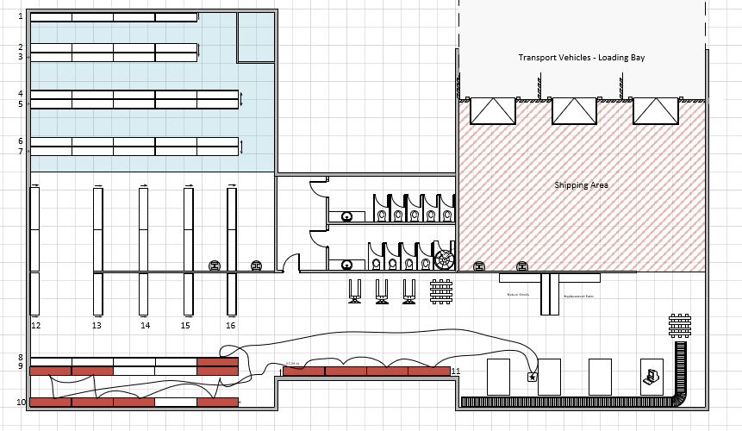
Plant Restructure – New Layout
Every problem has a solution

Slide 13
Implementation Plan
Improving the operations
01
02
03
04
05
Moving of component from current shelf to new shelf
Hiring new pick-up staff
Reducing the wage bill
Training and mock drill
Planned break schedule

Slide 14
Financial Model

Slide 15
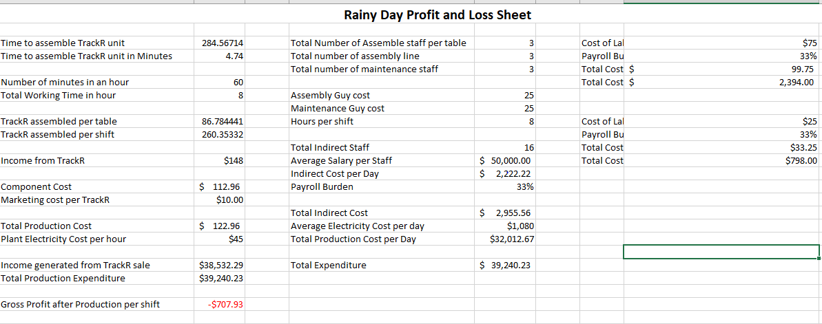
ROI
Reaching the break-even point – As-Is rainy day

Slide 16
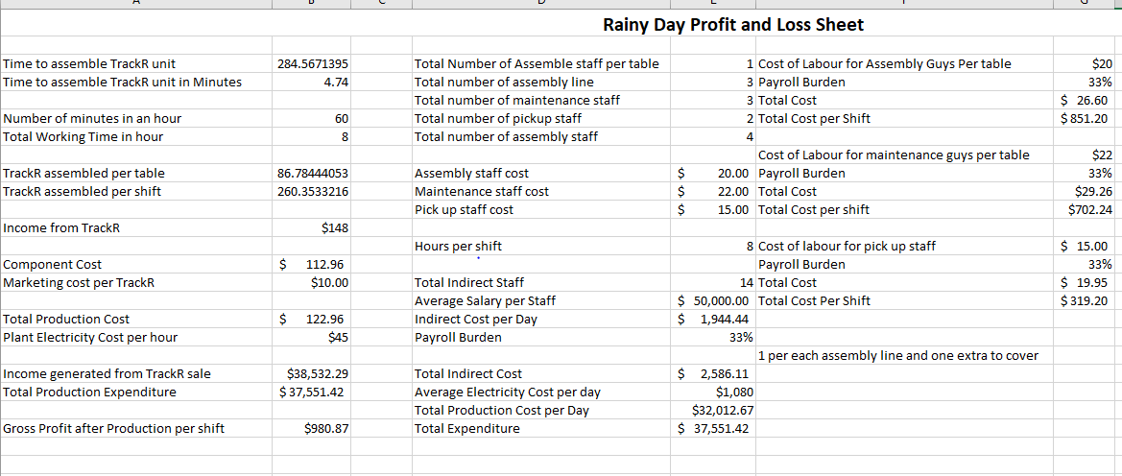
ROI
Reaching the break-even point – To-Be sunny day

Slide 17
Budgeting & Timeline
Money and Time Matters
Expenditure / Cost | As-IS | To-Be | Description
Revenue Generated through TrackR Sale | $38,532.29 | $38,532.29 | Number of TrackR production will remain same in As-To be model
Total Expenditure | $39,240.23 | $ 37,551.42 | Total Expenditure is reduced
Total Staff | 12 | 9 | Improved staff productivity
Total Cost of Labor | $ 3192.00 | $ 1,872.64 | Reduce labour cost
Pickup Time | 186.64 s | 61.14 s | Reducing Pick up timing
Profit- Loss | $(707.92) | $980.87 | As- Is Process making profit

Slide 18
Estimated Profit
$980.00

Slide 19
Conclusion for Solution 1
Project Task Accomplished
Production Plant Restructured
Optimizing the pick-up process
Reducing the labor cost
Hiring new, young and fast paced staff
Meeting the Breakeven Point

Slide 20
Solution Plan - II
Gayathari

Slide 21
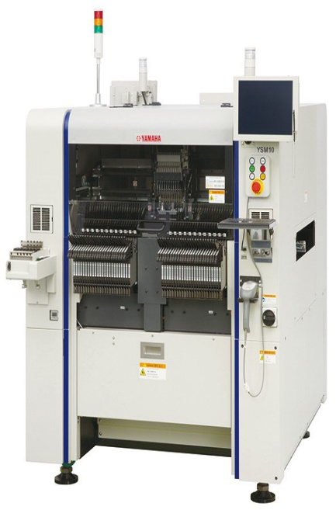
Optimal Solution-Yamaha YSM 10
Compact automated Mounting and Soldering Machine
Mounting speed 46,000 CPH feeder capacity 96 lanes
Cost $162,000 with three years warranty
Time taken 1.9 Seconds with 0.06% Failure Rate
25% speeder than other conventional models
Enhanced functionality to provide table production

Slide 22
Contd…
AS-IS
TO-BE
Sunny Day
Total Time to assemble -3.891667
Total Production per Table per shift-123.3404711
Total Production per shift-370.0214133
Rainy Day
Total Time to assemble -4.74
Total Production per Table per shift-88.55555157
Total Production per shift-265.6666547
Sunny Day
Total Time to assemble-3.335
Total Production per Table per shift-143.928036
Total Production per shift-431.7841079
Rainy Day
Total Time to assemble -3.62
Total Production per Table per shift-115.939597
Total Production per shift-347.818792

Slide 23
Profit/Loss
AS-IS
TO BE
Income generated from TrackR sale-$37,193.33
Total Production Expenditure-$38,609.50
Gross Profit after Production per shift--$1,416.17
Income generated from TrackR sale-$51,477.18
Total Production Expenditure-$48,363.40
Gross Profit after Production per shift-$3,113.78

Slide 24
ROI
ROI for Yamaha YSM 10
 | Year 1 | Year 2 | Year 3
Investment | 1,62,000 | - | -
Maintenance | 0 | 5000 | 5000
Profits per shift | 3113.781163 | 3113.781 | 3113.781
Profit per year | 750421.2604 | 784672.9 | 784672.9
Total Profit | 750421.2604 | 779672.9 | 779672.9
ROI | 363.2230002 | 15493.46 | 15493.46
Cost of Yamaha YSM 10 | 1,62,000
Number of days to get returns on investment | 9.635571508
Profit per shift | 15567.3174
Production per month | 21 days
Production per year | 252

Slide 25
Solution Plan III
Ruhi Ruhi – Six Sigma

Slide 26
Six Sigma- What is it?
Indicator of process efficiency
Problem solving method- DMAIC, DMADV
Toolbox for process, analysis and statistics
Operative and productive process improvement
Customer requirements
Quality initiatives- increased revenues and lower costs

Slide 27
Six Sigma- key principles
Focus on Customer Needs
Identify Root Cause
Variation Reduction
Stakeholder Improvement
Business Agility

Slide 28
Six Sigma methodology
Define
Measure
Analyze
Improve
Control

Slide 29
Six sigma- a look at the numbers
3.4 Defects per million
99.9997% perfection

Slide 30
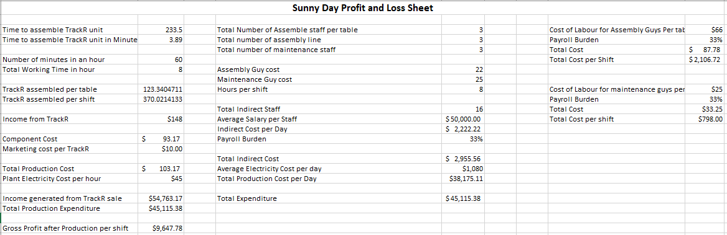
Six sigma- our implementation

Slide 31
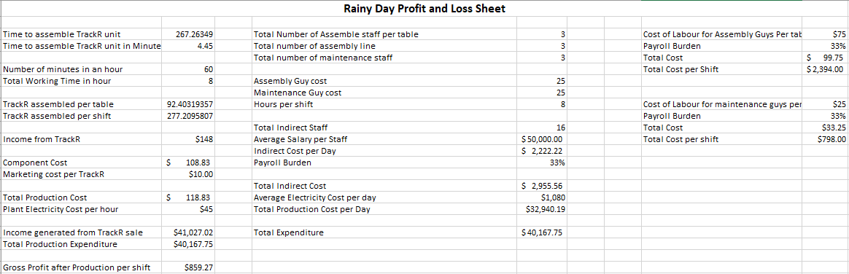
Six sigma- our implementation

Slide 32
Conclusion
Better trained workforce
Highly efficient assembly process
Higher profits per TrackR
Reduced failure rates
Lower component cost

Slide 33
Solution Plan IV
Gurpreet Singh

Slide 34
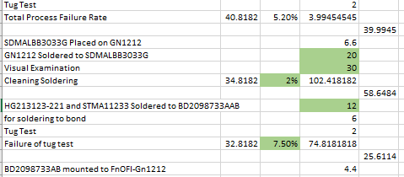
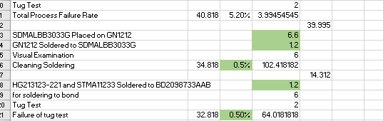
Reducing the Soldering Time
Reduced Fail rates.
Reduced pay and soldering time.
As-is Making time
To-be making time

Slide 35
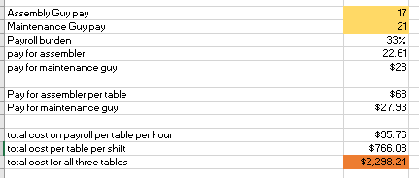


About New labor cost
Paying Assembly workers $17 per hour .
Paying Maintenance worker $21 per hour.
Making profit $400/shift all three tables.

Slide 36
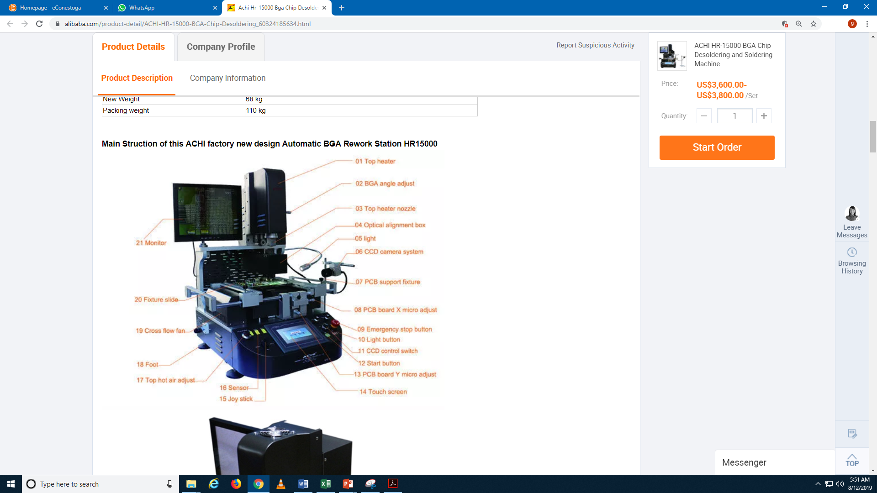
About Laser Soldering machine
Brand and origin: ACHI Organization China
Price:- 3600 per unit
Warranty:- 1 year
Camera can Observe soldering melting process
Laser positioning automated or manual.
Free technical support always.
Assistant videos are also provided.
Free Installation.
ACHI HR-15000 BGA Chip De-soldering and Soldering Machine

Slide 37
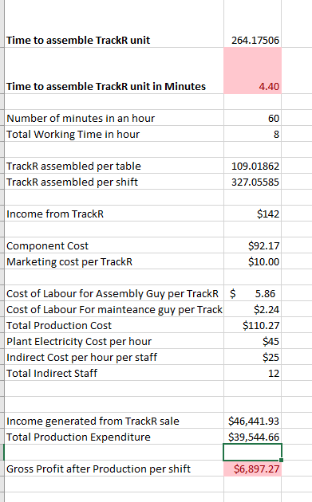
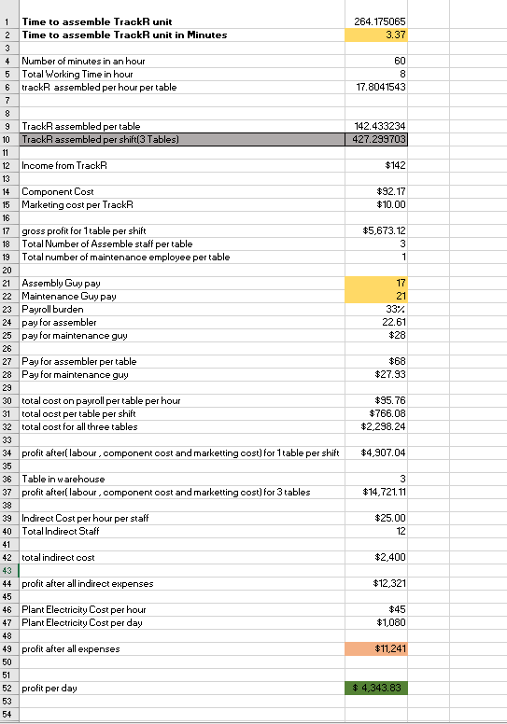
Sunny Day AS-IS and TO-BE

Slide 38
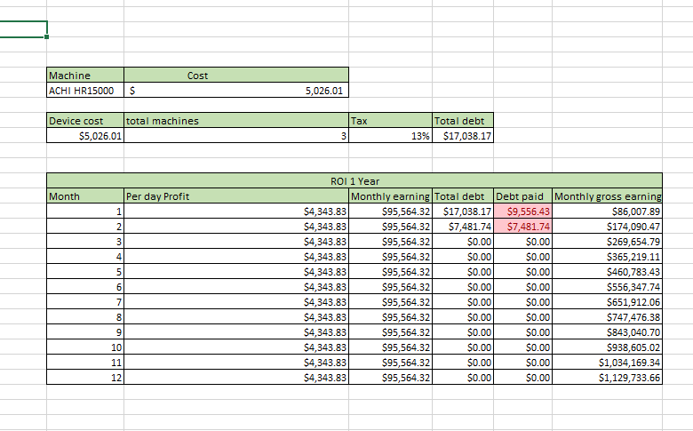
Return on Investment(ROI)

Slide 39
Health and safety concern Narinder Singh
Improper distribution of the ventilation
Low light issues in production area.
Harmful gases released during soldering.
Improper circulation of the air.
Safety standards of organization.
Noise pollution from shipping location.

Slide 40
Effects
Increase in payroll burden including medical expenses.
Worker efficiency decreased.
Failure rate increased.
High number if sick calls.
Heat stress and exhaustion.
Respiratory problem due to fumes released by soldering.

Slide 41
Solution
Installation of vent over assembly area.
Anti fatigue mat provided at assembly line.
Installation of light bulbs.
Provide respiratory masks.
Provide safety glasses.
Provide hearing aids to workers.
Installation of exhaust fans.

Slide 42
Benefits
Increase in efficiency of the employees.
Decrease in payroll burden.
Enhancement of the factory environments.
Decrease in failure rate.
Increase in production Quality.

Slide 43
Equipment and cost
Equipment’s | Cost in CAD
3 Anti-Fatigue Mat- | 432.00
24 Anti fog safety glasses | 85.20
Six Exhaust fans | 2263.86
19 Light bulbs | 6914.49
50 Respiratory Mask | 1250.00
Ventilation duct | 20.00
Total spending | 10965.55

Slide 44
Return on investment
ROI 1 Year
Month | Per day Profit | Monthly earning | Total debt | Debt paid | Monthly gross earning
1 | $3,533.66 | $77,740.56 | $10,965.55 | $3,887.03 | $73,853.54
2 | $3,533.66 | $77,740.56 | $7,078.52 | $3,887.03 | $147,707.07
3 | $3,533.66 | $77,740.56 | $3,191.49 | $3,191.49 | $222,256.14
4 | $3,533.66 | $77,740.56 | $0.00 | $0.00 | $299,996.71
5 | $3,533.66 | $77,740.56 | $0.00 | $0.00 | $377,737.27

Slide 45
Sunny day (AS-IS vs TO-BE)
Assembly Guy pay | 20
Maintenance Guy pay | 23
Payroll burden | 22%
pay for assembler | 24.4
pay for maintenance guy | $28
Pay for assembler per table | $73
Pay for maintenance guy | $28.06
total cost on payroll per table per hour | $101.26
total ocst per table per shift | $810.08
total cost for all three tables | $2,430.24
profit after( labour , component cost and marketting cost) for 1 table per shift | $4,812.98
Table in warehouse | 3
profit after( labour , component cost and marketting cost) for 3 tables | $14,438.94
Indirect Cost per hour per staff | $30.50
Total Indirect Staff | 12
total indirect cost | $2,928
profit after all indirect expenses | $11,511
Plant Electricity Cost per hour | $45
Plant Electricity Cost per day | $1,080
profit after all expenses | $10,431
profit per day | $ 3,314.54
Assembly Guy pay | 20
Maintenance Guy pay | 23
Payroll burden | 33%
pay for assembler | 26.6
pay for maintenance guy | $31
Pay for assembler per table | $80
Pay for maintenance guy | $30.59
total cost on payroll per table per hour | $110.39
total ocst per table per shift | $883.12
total cost for all three tables | $2,649.36
profit after( labour , component cost and marketting cost) for 1 table per shift | $4,739.94
Table in warehouse | 3
profit after( labour , component cost and marketting cost) for 3 tables | $14,219.82
Indirect Cost per hour per staff | $33.25
Total Indirect Staff | 12
total indirect cost | $3,192
profit after all indirect expenses | $11,028
Plant Electricity Cost per hour | $45
Plant Electricity Cost per day | $1,080
profit after all expenses | $9,948
profit per day | $ 2,831.42
Payroll burden decreased from 33% to 22%

Slide 46
AS-IS vs TO-BE
Cost of Labor for Assembly Guys Per table | $60
Payroll Burden | 22%
Total Cost | $ 73.20
Total Cost per Shift | $ 1,756.80
Cost of Labour for maintenance guys per table | $23
Payroll Burden | 22%
Total Cost | $28.06
Total Cost per shift | $673.44
Cost of Labor for Assembly Guys Per table | $60
Payroll Burden | 33%
Total Cost | $ 79.80
Total Cost per Shift | $ 1,915.20
Cost of Labour for maintenance guys per table | $23
Payroll Burden | 33%
Total Cost | $30.59
Total Cost per shift | $734.16
Cost of Labor for Assembly Guy per TrackR | $ 5.37
Cost of Labor For maintenance guy per TrackR | $2.06
Total Production Cost | $109.60
Plant Electricity Cost per hour | $45
Indirect Cost per hour per staff | $25
Total Indirect Staff | 12
Income generated from TrackR sale | $46,441.93
Total Production Expenditure | $39,325.54
Gross Profit after Production per shift | $7,116.39
Cost of Labor for Assembly Guy per TrackR | $ 5.86
Cost of Labor For maintenance guy per TrackR | $2.24
Total Production Cost | $110.27
Plant Electricity Cost per hour | $45
Indirect Cost per hour per staff | $25
Total Indirect Staff | 12
Income generated from TrackR sale | $46,441.93
Total Production Expenditure | $39,544.66
Gross Profit after Production per shift | $6,897.27

Slide 47
THANK YOU
TECH CRUSADER CONSULTANT
Contact Us: Techcrusader@work.com

